Slide 1
The Ombudsman’s New Powers
PSOW Act 2019: Shaping the Future
Pwerau Newydd yr Ombwdsmon
Deddf OGCC 2019: Llunio’r Dyfodol
Public Services Ombudsman for Wales
Ombwdsmon Gwasanaethau Cyhoeddus Cymru

Slide 2
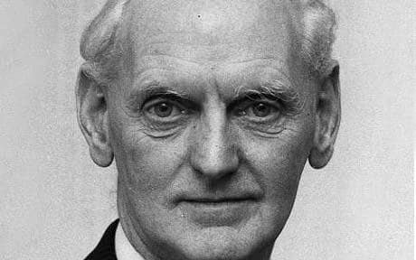
Why more powers? Pam mwy o bwerau?
Ageing population
Poblogaeth yn heneiddio
Inequality
Anghydraddoldeb
Improvement
Gwella
Trends
Tueddiadau

Slide 3
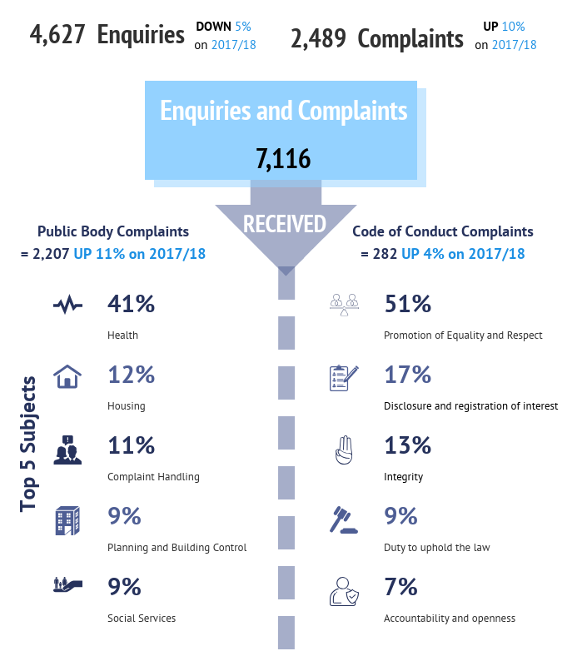
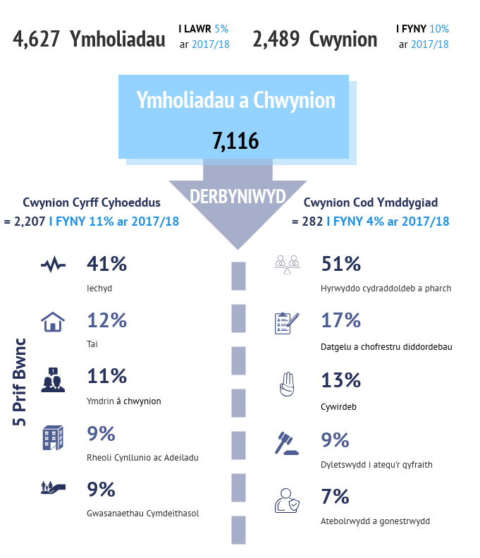
The Year in Summary – Cases Received
Crynodeb o’r flwyddyn – Achosion a Dderbyniwyd

Slide 4
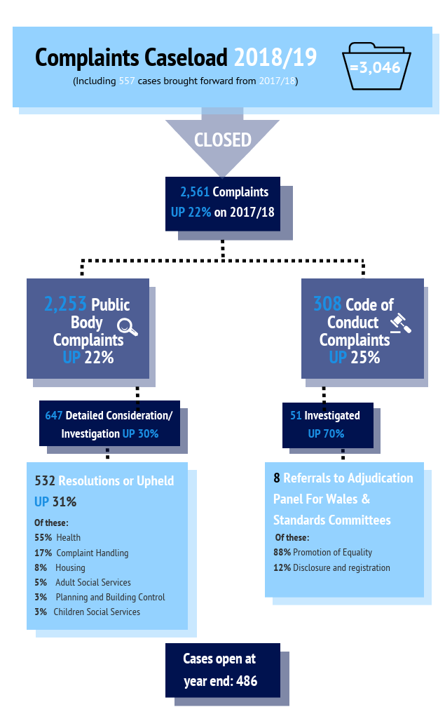
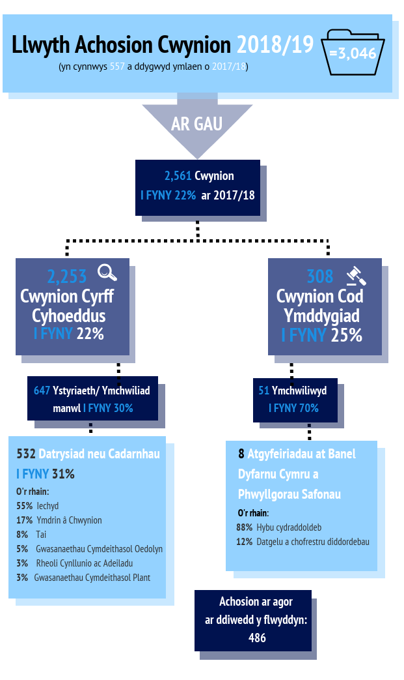
The Year in Summary – Closed Cases
Crynodeb o’r Flwyddyn – Achosion Caeëdig

Slide 5
Complaints about Private Health Care
Cwynion am Ofal Iechyd Preifat
Complaints about private health care
Cwynion am ofal iechyd preifat
Must include an element of NHS treatment
Rhaid cynnwys elfen o driniaeth GIG
It would be difficult to investigate the NHS care without considering the private care
Byddai’n anodd ymchwilio i ofal y GIG heb ystyried y gofal preifat
The complainant paid for private treatment
Talodd yr achwynydd am driniaeth breifat

Slide 6


Example Enghraifft
Mrs B had a 40-week wait for a scan
A private scan was undertaken in 3 weeks showing Mrs B needed urgent surgery for a hernia
NHS Consultant disagreed with finding. Mrs B was referred for a second scan which was undertaken 30 weeks later
With no surgery in sight, Mrs B paid for private surgery
Roedd gan Mrs B arhosiad o 40-wythnos am sgan
Cynhaliwyd sgan preifat mewn 3-wythnos, yn nodi bod Mrs B angen llawdriniaeth frys ar gyfer torgest
Anghytunodd Ymgynghorydd y GIG â’r canfyddiad. Cyfeiriwyd Mrs B am ail sgan, a gynhaliwyd 30-wythnos yn ddiweddarach
Heb unrhyw lawdriniaeth ar y gorwel, talodd Mrs B am lawdriniaeth breifat

Slide 7

Why we prefer complaints in writing
Pam mae'n well gennym gwynion ysgrifenedig
This ensures the complainant’s wishes are clear
All relevant information can be attached from the start
Mae hyn yn sicrhau bod dymuniadau'r achwynwyr yn glir
Gellir atodi'r holl wybodaeth berthnasol o'r dechrau

Slide 8

Complaints made other than in writing
Cwynion a wneir ar wahân i mewn ysgrifen
Telephone complaints
  30 minute appointment with an Adviser
  The call is recorded so that a summary can be created
  A copy of the summary will be shared with the complainant for checking
Cwynion dros y ffôn
  Apwyntiad 30 munud gydag Ymgynghorydd
  Recordir yr alwad fel y gellir creu crynodeb
  Bydd copi o'r crynodeb yn cael ei rannu gyda'r achwynydd i'w wirio

Slide 9
Own Initiative Investigations
Ymchwilio ar ei liwt ei hun
Annie Ginwalla & Beverley Allen
Public Services Ombudsman for Wales
Ombwdsmon Gwasanaethau Cyhoeddus Cymru

Slide 10
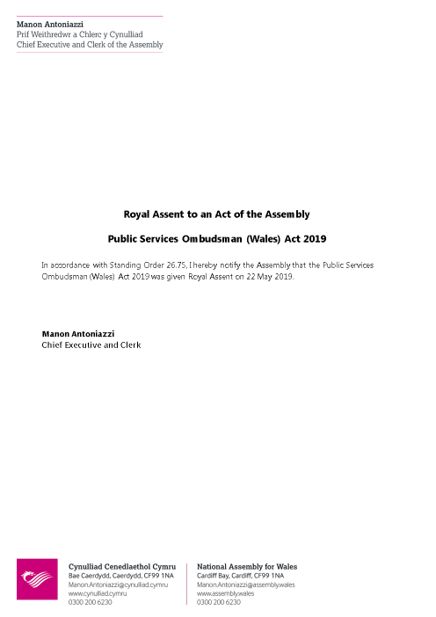
PSOW Act 2019 Deddf OGCC 2019
Empowers the
Ombudsman to
investigate
matters of
service failure or
maladministration,
whether a
complaint has
been duly made
or referred to him
or not
Yn grymuso'r Ombwdsmon i ymchwilio i faterion o fethiant gwasanaeth neu gamweinyddu, pa un a yw cwyn wedi'i gwneud yn briodol neu wedi'i chyfeirio ato ai peidio

Slide 11
What can we investigate?
Beth y gallwn ei ymchwilio?
(a) Suspected maladministration by a listed authority in connection with relevant action; or
(b) A suspected failure in a relevant service provided by a listed authority; or
(c) A suspected failure by a listed authority to provide a relevant service.
(a) Amheuaeth o gamweinyddu gan awdurdod rhestredig mewn cysylltiad â chamau perthnasol; neu
(b) Amheuaeth o fethiant mewn gwasanaeth perthnasol a ddarperir gan awdurdod rhestredig; neu
(c) Amheuaeth o fethiant gan awdurdod rhestredig i ddarparu gwasanaeth perthnasol.

Slide 12
Own Initiative Investigations
Ymchwilio ar ei liwt ei hun
Extended
  Extension to an existing investigation to include consideration of issues other than those complained about
Wider
  Stand alone investigation which does not relate to an individual complainant
Estynedig
  Estyniad i ymchwiliad presennol er mwyn ystyried materion ar wahân i'r rhai y cwynir amdanynt
Ehangach
  Ymchwiliad ar ei ben ei hun nad yw'n ymwneud ag achwynydd unigol

Slide 13

Own Initiative Investigations – Extended
Ymchwilio ar ei liwt ei hun - Estynedig
Current Investigation
  Aspects of service or care which were not raised by the complainant
  Another body which has provided a service or care to the complainant
Ymchwiliad Cyfredol
  Agweddau ar wasanaeth neu ofal nas godwyd gan yr achwynydd
  Corff arall sydd wedi darparu gwasanaeth neu ofal i'r achwynydd

Slide 14


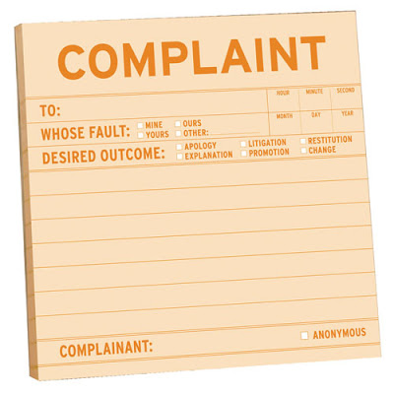
Examples Enghreifftiau
GP complaint
Cwyn am Feddyg Teulu
WAST complaint
Cwyn am YGAC
Complaint handling issues
Materion yn ymwneud ag
ymdrin â chwynion

Slide 15
Own Initiative Investigations – Wider
Ymchwilio ar ei liwt ei hun - Ehangach
Own Initiative Investigation
Ymchwilio ar ei liwt ei hun
Whistleblowers
Chwythwr chwiban
Anonymous complaints
Cwynion dienw
PSOW Investigations and intelligence
Ymchwiliadau a chudd-wybodaeth OGCC
Third Partes: regulatory bodies, service user groups, MP/AMs
Trydydd Partïon: cyrff rheoleiddio, grwpiau defnyddwyr gwasanaeth, AS / AC
Concerns about whole or part of a sector of public service
Pryderon am sector gwasanaeth cyhoeddus cyfan neu ran ohono
Actions of other bodies in same sector or service
Gweithredoedd gan gyrff eraill yn yr un sector neu wasanaeth

Slide 16

Example Enghraifft
Mrs A lived in a care home and had no family
She was admitted to hospital
“Do not resuscitate” decision taken without discussion with Advocate or any other representative
Roedd Mrs A yn byw mewn cartref gofal ac nid oedd ganddi deulu
Cafodd ei derbyn i'r ysbyty
Penderfynwyd “peidio â cheisio adfywio” heb drafod gydag Eiriolwr neu unrhyw gynrychiolydd arall
This Photo by Unknown Author is licensed under CC BY-SA-NC

Slide 17

Considerations
Ystyriaethau
Sufficient evidence to demonstrate the need for wider ‘own initiative’ investigation
Suggests or indicates that maladministration/ service failure has occurred, exists or there is potential for it to happen
Tystiolaeth ddigonol i ddangos yr angen am ymchwiliad ‘ar ei liwt ei hun’ ehangach
Sy’n awgrymu, neu sy'n dangos bod camweinyddu/ methiant gwasanaeth wedi digwydd, yn bodoli neu fod potensial iddo ddigwydd

Slide 18

Criteria for Own Initiative Investigations
Meini prawf ar gyfer Ymchwilio ar ei liwt ei hun
Public interest
Er budd y cyhoedd
Reasonable suspicion of systemic maladministration that may cause injustice or hardship
Amheuaeth resymol o gamweinyddu systemig a all achosi anghyfiawnder neu galedi
The impact on citizens who may be vulnerable or disadvantaged
Yr effaith ar ddinasyddion a all fod yn agored i niwed neu'n ddifreintiedig
Weight of the evidence
Cryfder y dystiolaeth
How persuasive is the evidence?
Pa mor argyhoeddiadol yw'r dystiolaeth?

Slide 19

Own Initiative Investigations
The Process
Ymchwilio ar ei liwt ei hun
Y Broses

Slide 20

Consultation – Extended Investigations
Ymgynghori - Ymchwiliadau Estynedig
Inform relevant parties
Hysbysu'r partïon perthnasol
Give relevant parties an opportunity to comment
Rhoi cyfle i’r partion perthnasol wneud sylwadau

Slide 21
Process – Wider Investigations
Proses – Ymchwiliadau Ehangach
Idea
Consultation
Proposal for investigation
Invite RB comments
Assess comments
Investigation
Report
Syniad
Ymgynghoriad
Cynnig ar gyfer ymchwiliad
Gwahodd sylwadau gan GP
Asesu’r sylwadau
Ymchwiliad
Adroddiad

Slide 22

Wider Investigations - Ideas
Ymchwiliadau Ehangach - Syniadau
Media Reports
Advocacy Services
Previous/Ongoing investigations
Interested 3rd parties
Improvement Officers following concerns about a specific body/sector
Adroddiadau yn y cyfryngau
Gwasanaethau Eiriolaeth
Ymchwiliadau blaenorol/ parhaus
3ydd partïon sydd â diddordeb
Swyddogion Gwella yn dilyn pryderon am gorff/ sector penodol

Slide 23
Consultation – Wider Investigations (1)
Ymgynghori - Ymchwiliadau Ehangach (1)
Consult with 1 or more:
  Welsh Commissioners
  Regulatory Bodies
  Auditor General
  Advertise on the PSOW website or in the media
Ymgynghori ag 1 neu fwy:
  Comisiynwyr Cymru
  Cyrff Rheoleiddio
  Yr Archwilydd Cyffredinol
  Hysbysebu ar wefan OGCC neu yn y cyfryngau

Slide 24
Consultation – Wider Investigations (2)
Ymgynghori - Ymchwiliadau Ehangach (2)
Create a proposal of the investigation
Invite the Relevant Body to comment
Assess all comments
Creu cynnig ynglŷn ag ymchwiliad
Gwahodd sylwadau gan y Corff Perthnasol
Asesu’r holl sylwadau

Slide 25

Investigation Ymchwiliadau
Investigations will be managed in accordance with the existing PSOW complaint handling process
Bydd ymchwiliadau'n cael eu rheoli yn unol â phroses gyfredol OGCC wrth ymdrin â chwynion

Slide 26

Reports
Adroddiadau
Public reports
  Published on the PSOW website
  Body should make a copy available for 3 weeks after publication at the office and on website
  Place a notice in a newspaper circulating in the area
Adroddiadau cyhoeddus
  Cyhoeddi ar wefan OGCC
  Dylai corff sicrhau bod copi ar gael am 3 wythnos ar ôl cyhoeddiad, hynny yn y swyddfa ac ar y wefan
  Rhoi hysbysiad mewn papur newydd sy'n cylchredeg yn yr ardal

Slide 27
The Complaints Standards Authority
Yr Awdurdod Safonau Cwynion
Although in Wales many have adopted the relevant complaints procedures, queries over to what degree they are being implemented effectively.
Simplify the process
Data: ensuring common approach to data gathering allows insight in relation to trends and patterns across public service delivery in Wales.
Er bod llawer o bobl yng Nghymru wedi mabwysiadu'r gweithdrefnau cwyno berthnasol, maent yn holi i ba raddau y maent yn cael eu gweithredu'n effeithiol.
Symleiddio’r broses
Data: mae sicrhau dull cyffredin o gasglu data yn caniatáu mewnwelediad mewn perthynas â thueddiadau a phatrymau ar draws darparu gwasanaethau cyhoeddus yng Nghymru.

Slide 28
Discussion
Trafodaeth
PSOW Act 2019: Shaping the Future.
The impact of the new powers on Relevant Bodies – Are there barriers to the new process?
Deddf OGCC 2019: Llunio'r Dyfodol.
Effaith y pwerau newydd ar Gyrff Perthnasol - A oes rhwystrau i'r broses newydd?

Slide 29
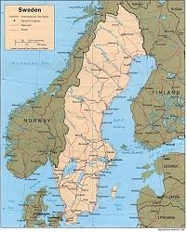
Global best practice
Arfer gorau byd-eang

Slide 30
Questions
Cwestiynau

Slide 31
Criteria for Own Initiative Investigations
Meini prawf ar gyfer ymchwilio ar ei liwt ei hun
Public interest
Er budd y cyhoedd
Reasonable suspicion of systemic maladministration that may cause injustice or hardship
Amheuaeth resymol o gamweinyddu systemig a all achosi anghyfiawnder neu galedi
The impact on citizens who may be vulnerable or disadvantaged
Yr effaith ar ddinasyddion a all fod yn agored i niwed neu'n ddifreintiedig
Weight of the evidence
Cryfder y dystiolaeth
How persuasive is the evidence?
Pa mor argyhoeddiadol yw'r dystiolaeth?

Slide 32
Process – Wider Investigations
Proses – Ymchwiliadau Ehangach
Consult with interested parties
Create a proposal of the investigation
Invite comments from the Relevant Body
Assess all comments
Start the investigation (18/36 weeks)
Public interest report
Ymgynghori â phartïon sydd â diddordeb
Creu cynnig ynglŷn ag ymchwiliad
Gwahodd sylwadau gan y Corff Perthnasol
Asesu’r holl wybodaeth
Cychwyn yr ymchwiliad (18/36 wythnos)
Adroddiad er budd y cyhoedd

